Slide 1
FSA 3rd Grade Parent Information
September 13, 2018
Franklin Academy
Cooper City Campus

Slide 2
Gain an understanding of the Florida Standards
Expectations of the FSA including question types
Sessions, times, and dates
Objectives

Slide 3
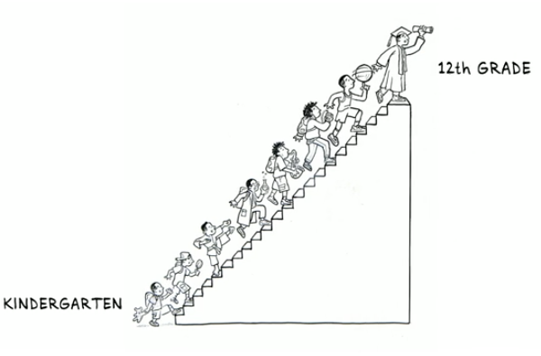
What are the Florida Standards?
“A set of clear, consistent and strong academic standards that will help ensure Florida’s students graduate high school ready for success in college, career and life.”
Florida Standards

Slide 4
Cognitive Complexity

Slide 5
The Florida Standards Assessment (FSA)
FSA is an authentic assessment that includes more than just multiple choice questions.
It will prepare Florida students for success in college, career, and in life by emphasizing analytical thinking.
Students will be expected to respond to multiple choice questions, create graphs, write and respond in different ways than on other traditional tests.
Measures student mastery of the standards taught.
Meets high quality standards for assessment, including reliability and validity for a variety of accountability purposes.
Emphasizes critical thinking.
What is the FSA?

Slide 6
Sessions and Times

Slide 7
English Language Arts/Literacy
Focus on non-fiction and careful, focused reading.
Discuss reading and writing using evidence.
Increase academic vocabulary.
Use real-world examples to better understand concepts.

Slide 9
Mathematics
Learn more in-depth math by focusing on fewer concepts.
Focus on skill building, speed and accuracy.
Use real-world examples to better understand concepts.

Slide 10
FSA
All grades 3-6 ELA and Math will be delivered on paper in 2019.
Practice tests and Item Specifications will be updated in September 2018. (Current Paper Based (PBT) Practice Tests include item types that will be removed – use with caution)
PBT tests will NOT include:
Audio
Short answer

Slide 11
FSA Achievement Levels

Slide 12
Florida law defines Level 3 as indicating “satisfactory performance” (s. 1008.22(3)(e)1., F.S.)
Florida law also states that “a student passes an assessment if the student achieves a level 3, level 4, or level 5” (s. 1008.34(1)(a), F.S.)
Level 3 is also defined as “passing” in State Board Rule (6A-1.09422, F.A.C.)
FSA Achievement Levels

Slide 13
Testing Window: | Test: | Test Mode: | Grade (s):
April 2nd & 3rd, 2019 | FSA ELA Reading | Paper Based | 3rd
May 7th & 8th, 2019 | FSA Mathematics | Paper Based | 3rd
FSA Test Dates

Slide 14
Focusing on the standards
Differentiating instruction
Digital learning push
“Cold Read” Assessments with DBQs
Writing across content areas
Progress Monitoring in all subjects
Modeling FSA Style Questions on Assessments
Close Reading in all content areas
What are we doing?

Slide 15
fsassessments.org
bealearninghero.org
achievethecore.org
floridastudents.org
fldoe.org/academics – Florida Standards resources, parent guides and the “We Can Do This, Florida!” video series
A+ Resources

Slide 16
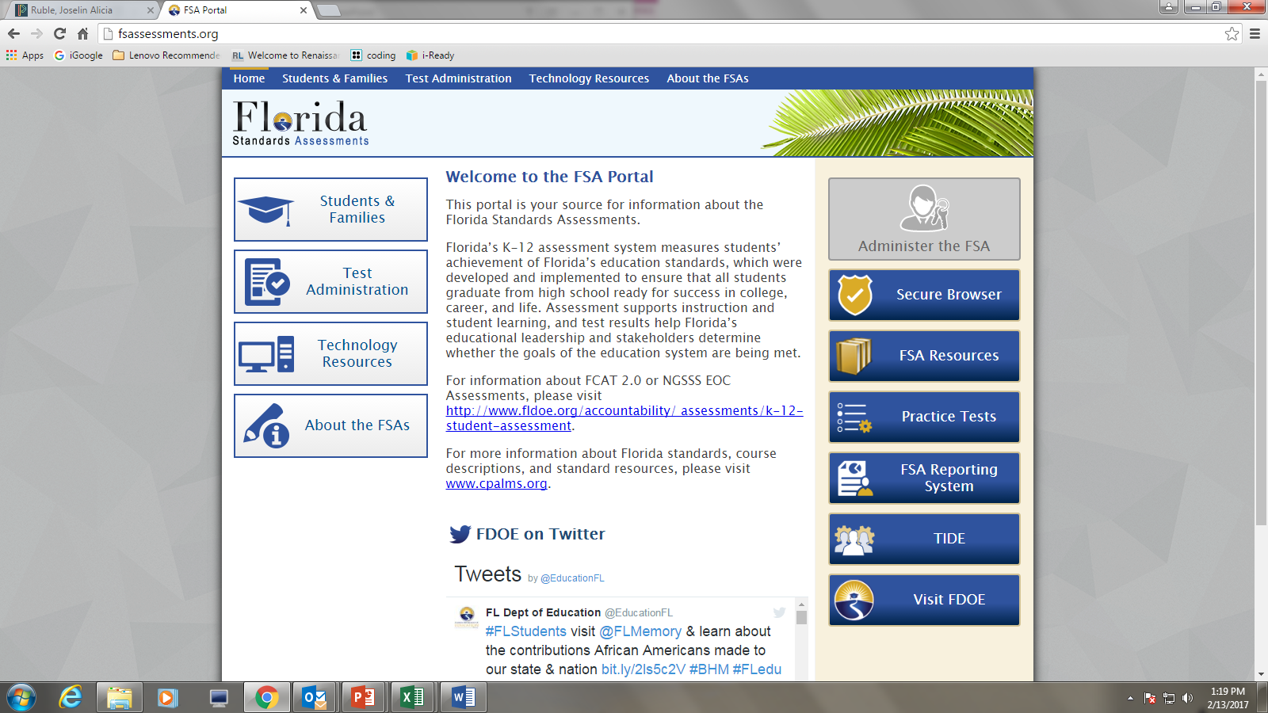
FSA Portal

Slide 17
Visit teacher websites on a daily basis.
Help infuse what is being learned in class at home.
READ with children at least 30 minutes each day. Students can then use the books read at home, and take tests at school using Accelerated Reader (AR) program.
Use computer websites:
PowerSchool– keep up-to-date with student progress
i-Ready
ThinkCentral.com
USA Test Prep
STEMScope
ED your friend in Learning
https://www.floridastudentsachieve.org/elementary/
https://www.floridastudentsachieve.org/middle-school/
http://fsassessments.org/ Use this website to read about updates, and have your child complete the training tests in both Reading and Math.
What can I do to help?

Slide 18
FSA Alternatives
Portfolios- All 3rd Graders will be working on an ELA Portfolio. If they do not score at least a 2 on their FSA, they can pass based on a passing score on their portfolio.
i-Ready end of year diagnostic
SAT 10- Students who do not pass their portfolio or are at risk of not earning at least a 2 on the FSA will be given the SAT10.

Slide 19
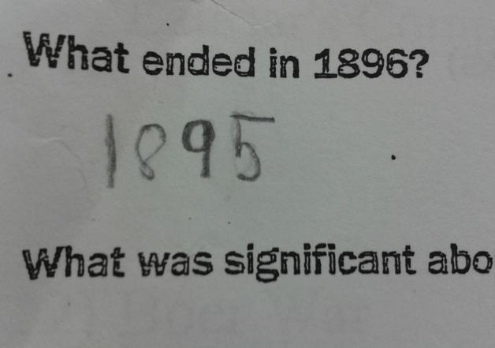
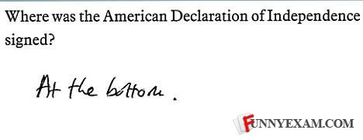
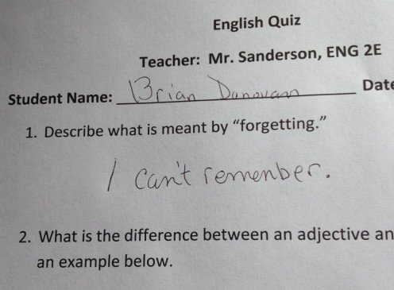
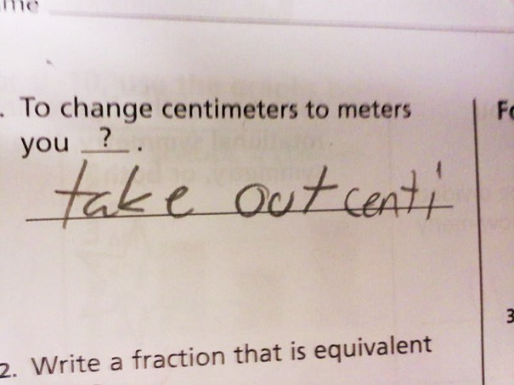
Relax and Laugh

Slide 20
Questions?
Mr. Ratner
ratner.jason@franklin-academy.org
954-780-5533x2307
Mrs. Lopez
lopez.evelyn@franklin-academy.org
954-780-5533x2309

